Slide 1
CSCI 2930 Practical System Administration
Lecture 4: Desktops and Tier 1 Support (Continued)

Slide 2
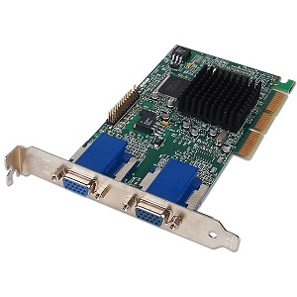
Desktop Components Video
Matrox
Millennium
G400/G450
Environment Bump Mapping
Professional 2D Graphics
Multi Head Support
Embedded Server Chips

Slide 3
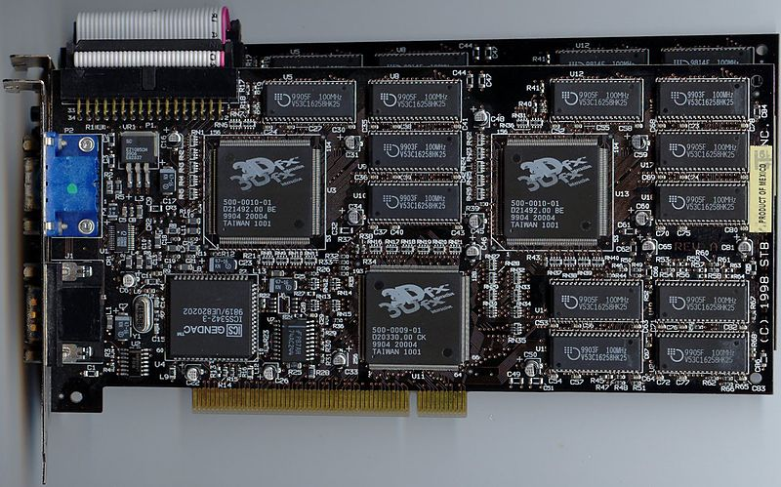
Desktop Components Video
3dFX
First real 3D accelerators
Voodoo PCI
Pass-through
Voodoo2 introduced Scan-Line Interleave (SLI) (Still required 2D card)
Two Voodoo2 boards were connected together, each drawing half the scan lines of the screen

Slide 4
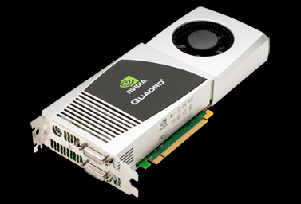
Desktop Components Video
Nvidia
Purchased 3dFX
GeForce (Gaming)
Quadro (Professional)
Tesla (Compute)
CUDA (Parallel/Programming – no Assembly)
Reintroduced SLI (Scalable Link Interface)
AMD/ATI
Radeon
APU’s
CrossFire

Slide 5
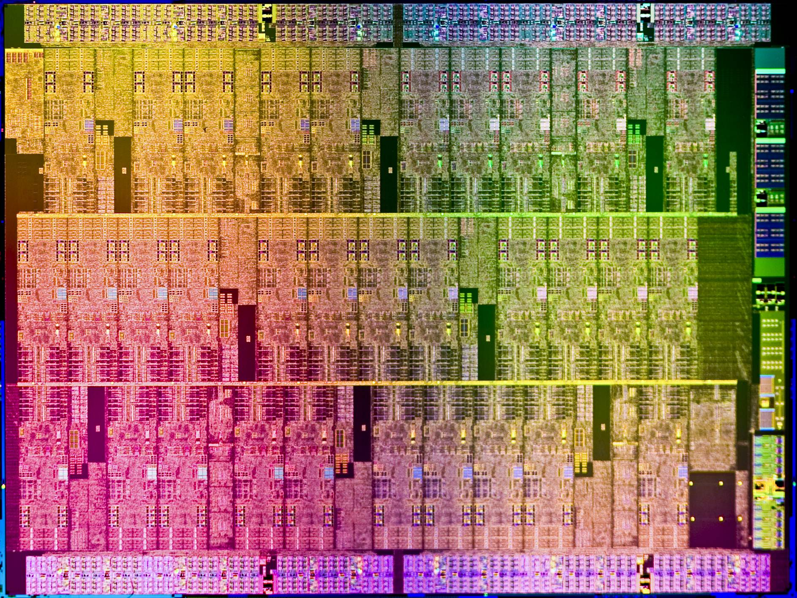
Desktop Components Video
Intel
Embedded chips on most lower-end mother boards
Integrated on CPU’s
MIC Compute (modified P54C)
(Many Integrated Core)
Larrabee
Knights Ferry (Prototype)
Knights Corner (22nm)
Knights Landing (14nm)
Xeon Phi (Product Family branding)
Supercomputing

Slide 6
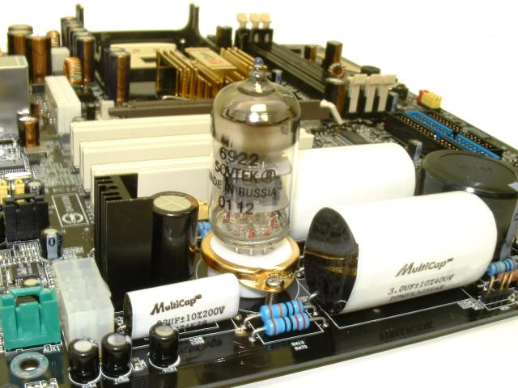
Desktop Components Audio
Typically integrated onto the motherboard
Line out
Line In
Rear/Center/Sub
S/PDIF Out (OPTICAL)
Microphone
Higher end boards provide 5.1 and 7.1 channels
Creative Labs de facto standard for discrete cards

Slide 7
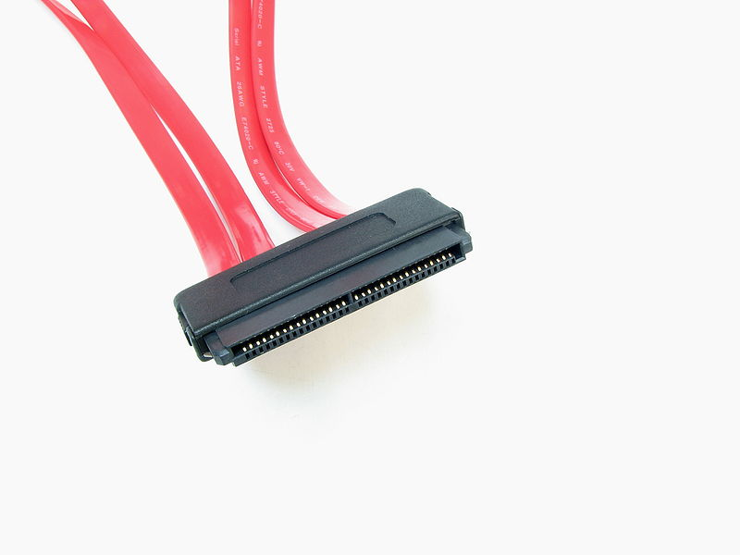
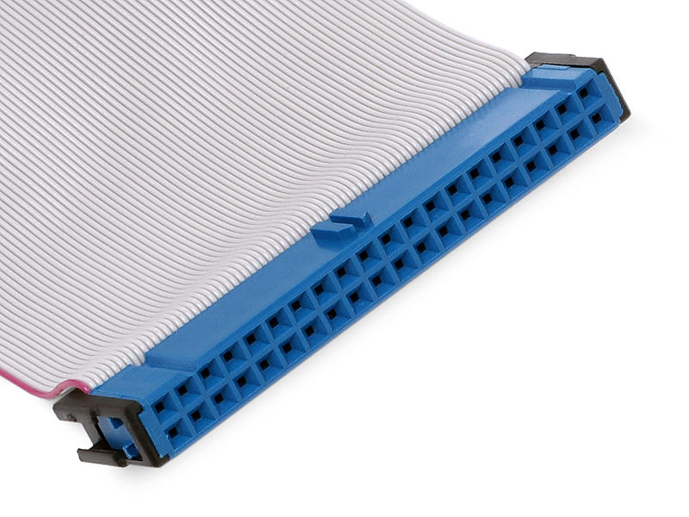
Desktop Components Local Storage
PATA (IDE)
Parallel ATA
Integrated Drive Electronics
SCSI
Small Computer System Interface
SATA
Serial ATA
SAS
Serial Attached SCSI
Discrete Cards
RAID
Redundant Array of Independent Disks

Slide 8
Desktop Components Local Storage
Parallel vs Serial
Parallel can send multiple streams of data
Able to clock Serial faster
Less crosstalk with Serial
Serial cables have less wires…take up less space
Notes:
Parallel originally used because it was easier to push more data with multiple streams at slower bus speeds

Slide 9
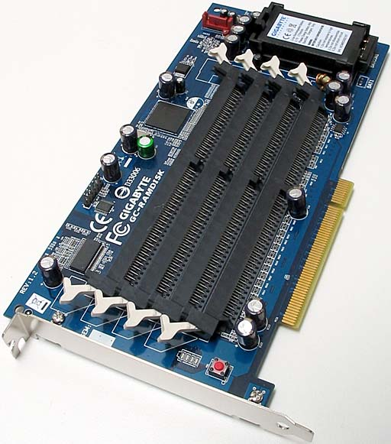
Desktop Components Hard Drives
Physical Sizes
5.25”
3.5”
2.5”
PCIe Cards
Media
Magnetic
SSD
RAM

Slide 10
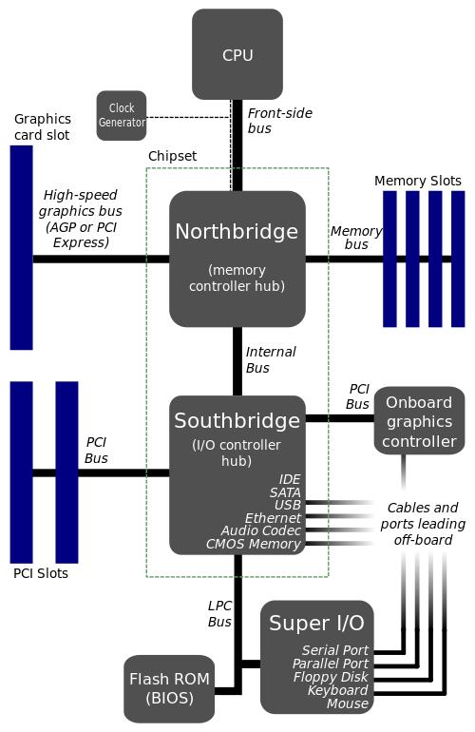
Desktop Components Motherboard
CPU Socket
Main memory slots
North Bridge
South Bridge
Non-volatile memory BIOS/Firmware chips
Clock Generator
Expansion Card Slots
Power Connectors
Integrated devices
Battery
Voltage Regulator Module (VRM)
Notes:
Show intel ark

Slide 11
Desktop Components Motherboard
Form Factor
AT
Full
Baby
ATX
Large number of sizes
Airflow specifications
Change in PSU connectors
Power Supply Revisions

Slide 12
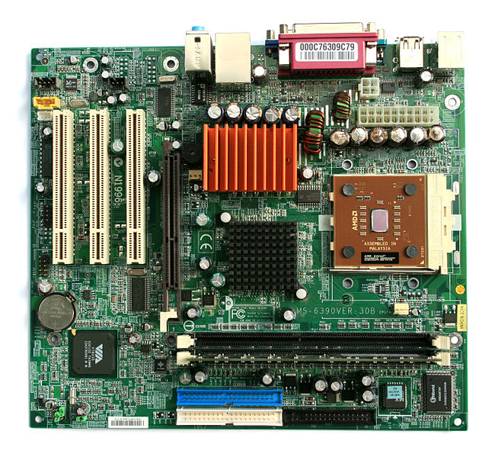
Desktop Components Motherboard

Slide 13
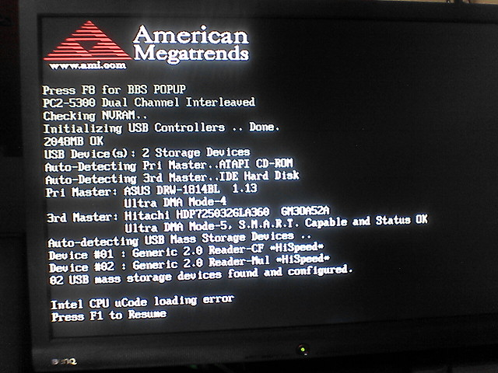
Desktop Components BIOS
Power-on-Self-Test POST
Verify CPU registers
Verify the integrity of the BIOS code itself
Verify some basic components like DMA, timer, interrupt controller
Find, size, and verify system main memory
Initialize BIOS
Pass control to other specialized BIOSes (if and when required)
Identify, organize, and select which devices are available for booting

Slide 14
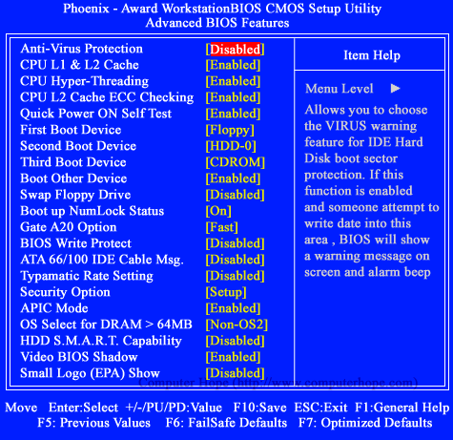
Desktop Components BIOS
Features
System clock
Security
Boot order
Special features dictated by chipsets and processors
Flashing
Separate boot environment
Within OS
Backup Chips

Slide 15
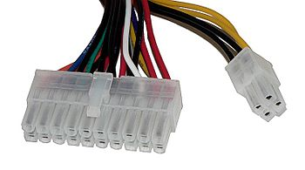
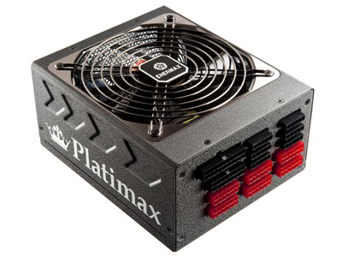
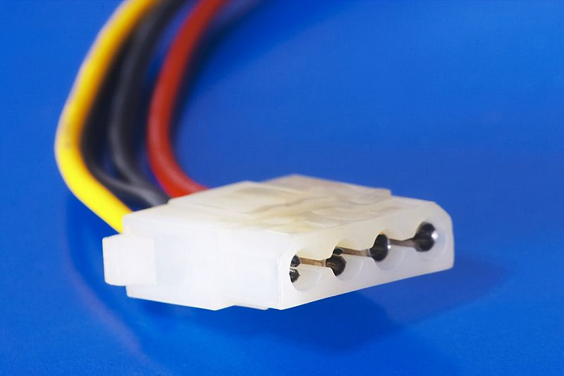
Desktop Components PSU
PSU
Watts vs Amp
The advent of high powered chips like the Opteron and P4 caused system builders to pay more attention to amps.
May list high wattage but didn’t have enough amps on the power attached to the CPU
Connectors
4 pin molex
SATA/SAS
MB Power
Floppy
Graphics
CPU

Slide 16
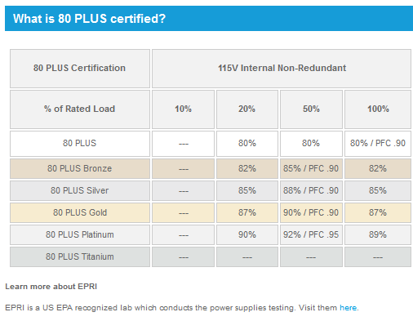
Desktop Components PSU
Efficiency
% of usable energy
Saves Money
Produces less heat

Slide 17
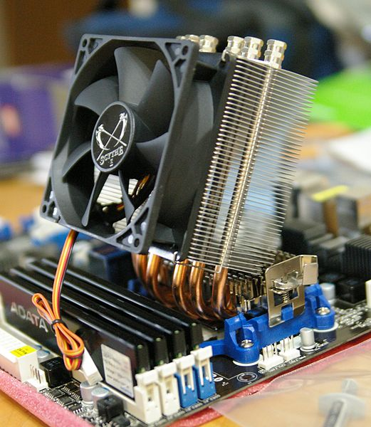
Desktop Components Cooling
Thermal Design Point/Power (TDP)
Airflow
Fans
Heat Sinks
Heat Pipe
Liquid
Submersion
Peltier (Thermoelectric)
Notes:
Liquid cooling is a highly effective method of removing excess heat, with the most common heat transfer fluid in desktop PCs being water. The advantages of water cooling over air cooling include water's higher specific heat capacity and thermal conductivity. The principle used in cooling computers is identical to that used in an automobile's internal combustion engine, with the water being circulated by a water pump through a block mounted on the CPU and out to a heat exchanger, typically a radiator.
A heat pipe is a hollow tube containing a heat transfer liquid. The liquid absorbs heat and evaporates at one end of the pipe. The vapor travels to the other (cooler) end of the tube, where it condenses, giving up its latent heat. The liquid returns to the hot end of the tube by gravity or capillary action and repeats the cycle.

Slide 18
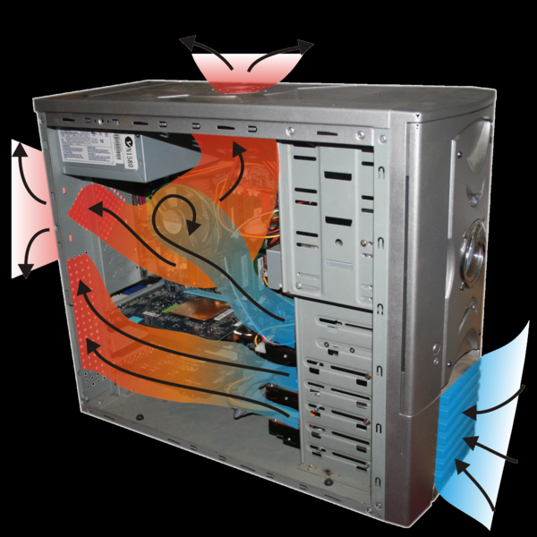
Desktop Components Cooling
Thermal Compound
Fills air gaps between two surfaces with a thermally conductive substance
Arctic Silver
Rounded Cables
Heat pockets
Notes:
Liquid cooling is a highly effective method of removing excess heat, with the most common heat transfer fluid in desktop PCs being water. The advantages of water cooling over air cooling include water's higher specific heat capacity and thermal conductivity. The principle used in cooling computers is identical to that used in an automobile's internal combustion engine, with the water being circulated by a water pump through a block mounted on the CPU and out to a heat exchanger, typically a radiator.
A heat pipe is a hollow tube containing a heat transfer liquid. The liquid absorbs heat and evaporates at one end of the pipe. The vapor travels to the other (cooler) end of the tube, where it condenses, giving up its latent heat. The liquid returns to the hot end of the tube by gravity or capillary action and repeats the cycle.

Slide 19
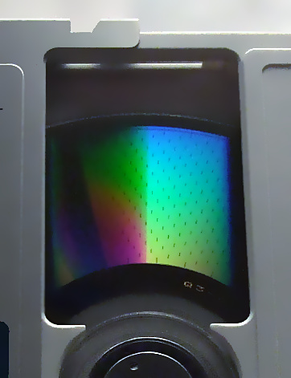
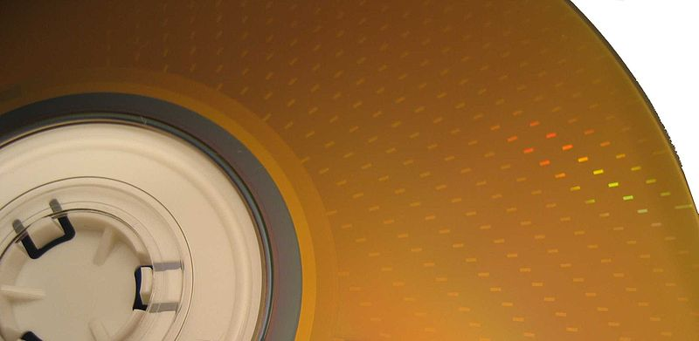
Desktop Components Optical Drives
Magneto Optical
650MB to 9.2GB
CD-ROM/R/RW
650MB
700MB
DVD-+ROM/R/RW
4.7GB – 9.4GB (Double Sided)
DVD-RAM
Accessed like a hard drive similar to MO
Higher Rewrite capacity and in hardware verification

Slide 20
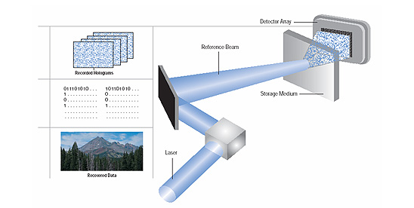
Desktop Components Optical Drives
Blu-ray (BD)
25GB Single Sided
50GB Double Sided
100GB Three layer
Hard Coat to protect against scratches
Player Profiles based on features
Holographic
300GB storage
Companies continue to go bankrupt

Slide 21
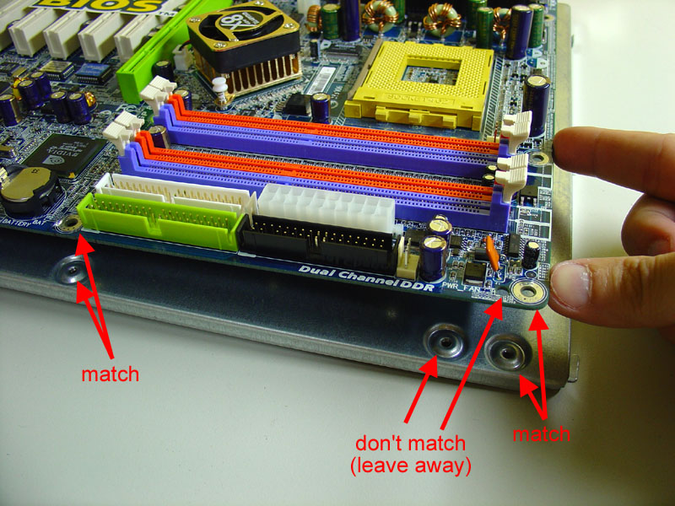
Desktop Components Cases
Form Factors
Materials
Fans
Controls
Connectors
PSU Location
Cable Management
Motherboard Mounting

Slide 22
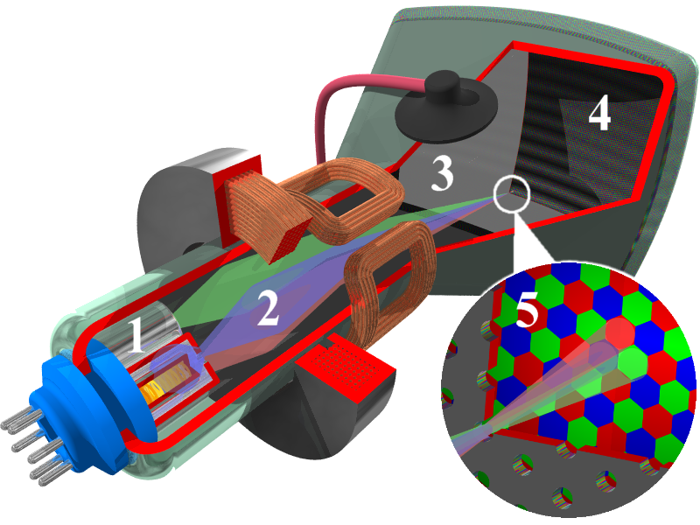
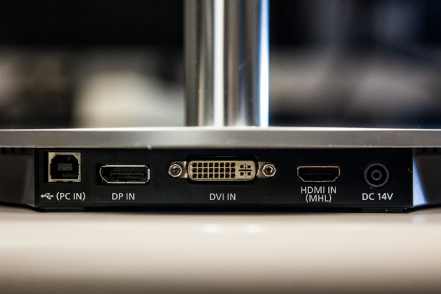
Monitors
CRT
LCD
LED
Brightness/Contrast
Viewing Angles
Connections
HDMI
Display Port
VGA
DVI
Recycling

Slide 23
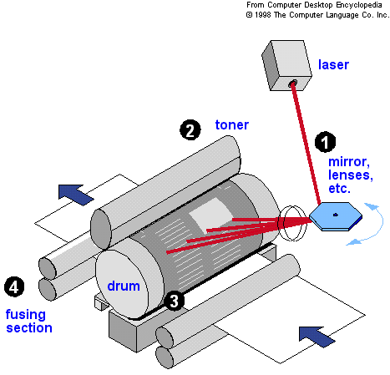
Printers
Inkjet
Create image by propelling droplets of ink onto paper
Inkjet Heads
Ink cartridges
Laser
Beam projects an image of the page to be printed onto an electrically charged rotating drum
Toner particles electrostatically picked up by the drum's charged areas
Drum prints the image onto paper by direct contact and heat, which fuses the ink to the paper

Slide 24
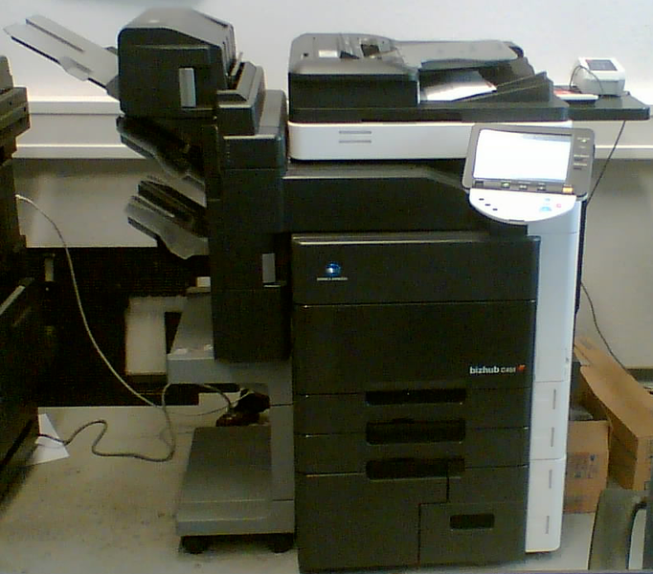
Printers
Multifunction
Print
Scan
Fax
Photocopy
Sharing
Local printer shared out through OS specific protocols
Built in Print Server
Central server with multiple network printers

Slide 25
Drivers
Translator between a hardware device and the applications or operating systems
Typical hardware devices that need special drivers:
Printers
Graphics Cards
Network Cards
Sound Cards
Storage
Cameras

Slide 26
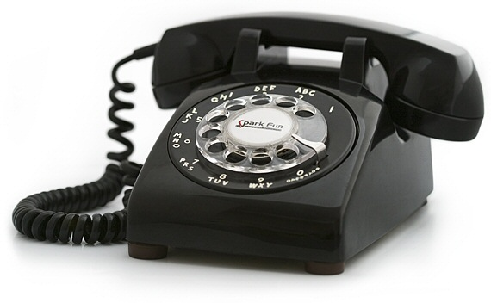
Warranty
Standard
Professional
Hours
9 – 5
24/7
Weekdays Only
Response Time
Depot Spares?
Apple

Slide 27
Benchmarking
Assess the relative performance of an object by running a number of standard tests and trials
3DMark
Graphics benchmark
PCmark
PC component benchmark for home user workloads
LINPACK
Linear Algebra
Used for Top 500 super computer list
SiSoft Sandra
Dhrystone (Integer)
Whetstone (Floating Point)
FLOPS – Floating-point Operations Per Second

Slide 28
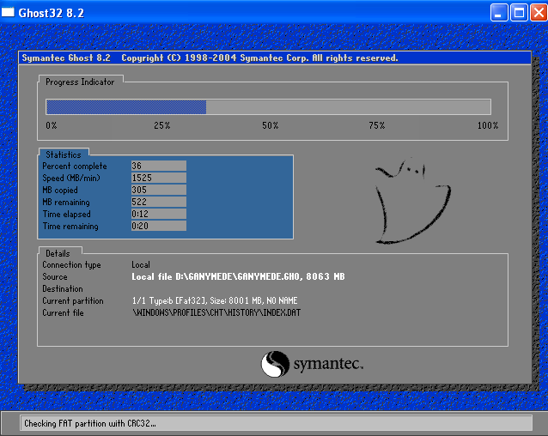
Imaging/PXE
The Preboot eXecution Environment (PXE)
Sometimes pronounced "pixie”
Boot computer using a network interface
Independent of data storage devices
Ghost - General Hardware-Oriented System Transfer
Kickstart
Automatically perform unattended operating system installation and configuration
dd

Slide 29
Lease vs Purchase
Lease
+ Equipment stays up-to-date
+ Predictable expenses
- Pay more in the long term
Rotation
Recycling

Slide 30
Helpdesk/Tickets
Software
Service Level Agreement (SLA)
Tier 1
Support level responsible for basic customer issues
Gather information and to determine the issue by analyzing the symptoms and figuring out the underlying problem
Tier 2
Responsible for assisting Tier I solving basic technical problems and for
Investigating elevated issues and seeking for known solutions related to these more complex issues

Slide 31
Helpdesk/Tickets
Tier 3
Experts in their fields
Responsible for assisting both Tier I and Tier II
Research and development of solutions to new or unknown issues
Priority
End user priority v Helpdesk priority

Slide 32
Helpdesk/Tickets
Feature | Support Included with Hardware Product Warranty | SupportEdge Standard | SupportEdge Premium
Storage System Installation | Not included but available for purchase | Not included but available for purchase | Included[*]
24x7 Remote Technical Support | Included | Included with hardware warranty | Included with hardware warranty
Target Response Objectives for Remote Technical Support | Not available | Priority 1: 2 hours Priority 2: 4 hours Priority 3: 16 hours Priority 4: 36 hours (all times on a 24x7 basis) | Priority 1: 30 minutes Priority 2: 2 hours Priority 3: 8 hours Priority 4; 24 hours (all times on a 24x7 basis)
Replacement Parts | Included | Included with hardware warranty | Included with hardware warranty
Replacement Parts Target Response Objectives and Installation | Next business day Customer installs all Replacement Parts. | Choose one of the following:[**] • 24x7, 4-hour (NetApp installs all Replacement Parts) • 24x7, 4-hour (Customer self-installs all Replacement Parts) • Next business day (NetApp installs all Replacement Parts) | NetApp installs all Replacement Parts. Choose one of the following:[**] • 24x7, 2-hour • 24x7, 4-hour • Next business day
Onsite Support | Not available | Not available | Included
Example:

